Slide 1
How to: Data Write-Back to Data Warehouse in Fabric from Power BI
by Jon Stjernegaard Vöge

Slide 2
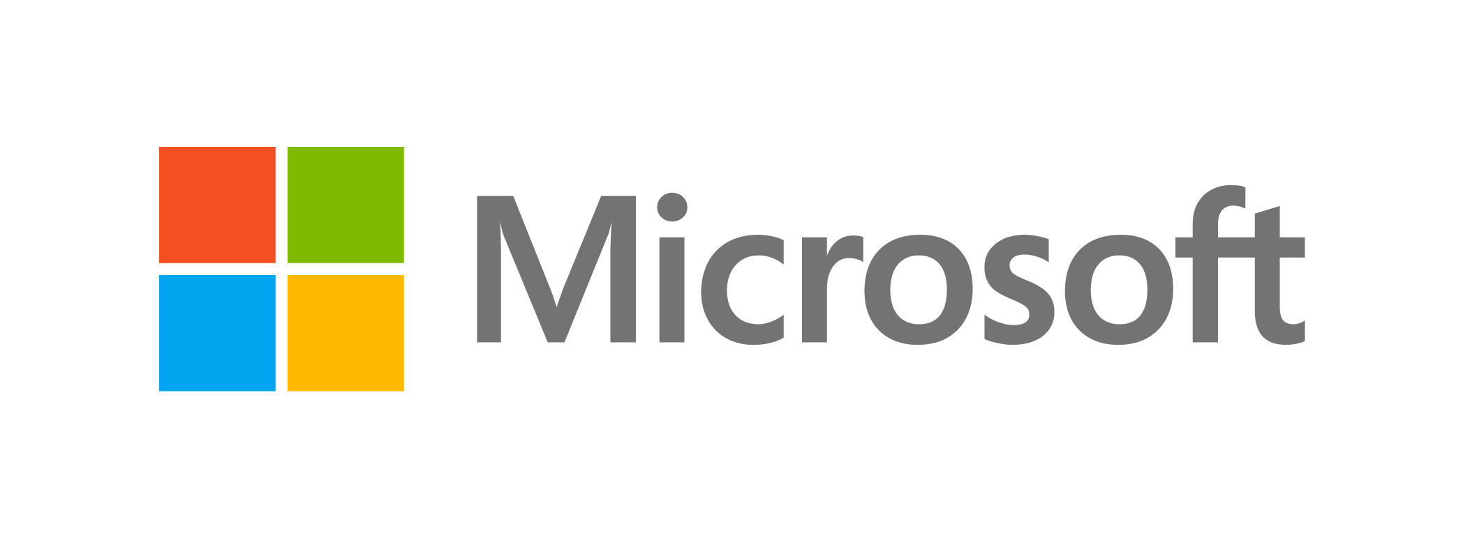

Special thanks to Fabric and Power BI Team at
This Summit presented to you by

Slide 3
Jon Stjernegaard Vöge
Senior Consultant at Inspari – a valantic company, driving Power Platform & Fabric projects and community engagement.
MSc. Business Administration & E-Business from Copenhagen Business School, Denmark
Empowering business users to work better with data, making better decisions, and take matter into their own hands.
28 years old, hobby cyclist, puzzle and board game nerd

Slide 4
Agenda
Demo of write-back to Fabric from Power BI
The Challenge: Why write-back in Fabric is not straightforward
The Solution: Using Power Automate
Q&A

Slide 5
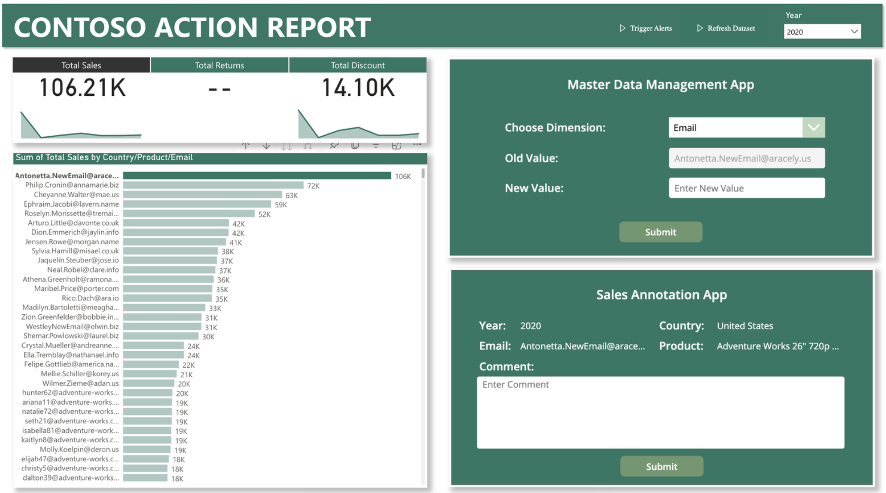
Solution Demo

Slide 6
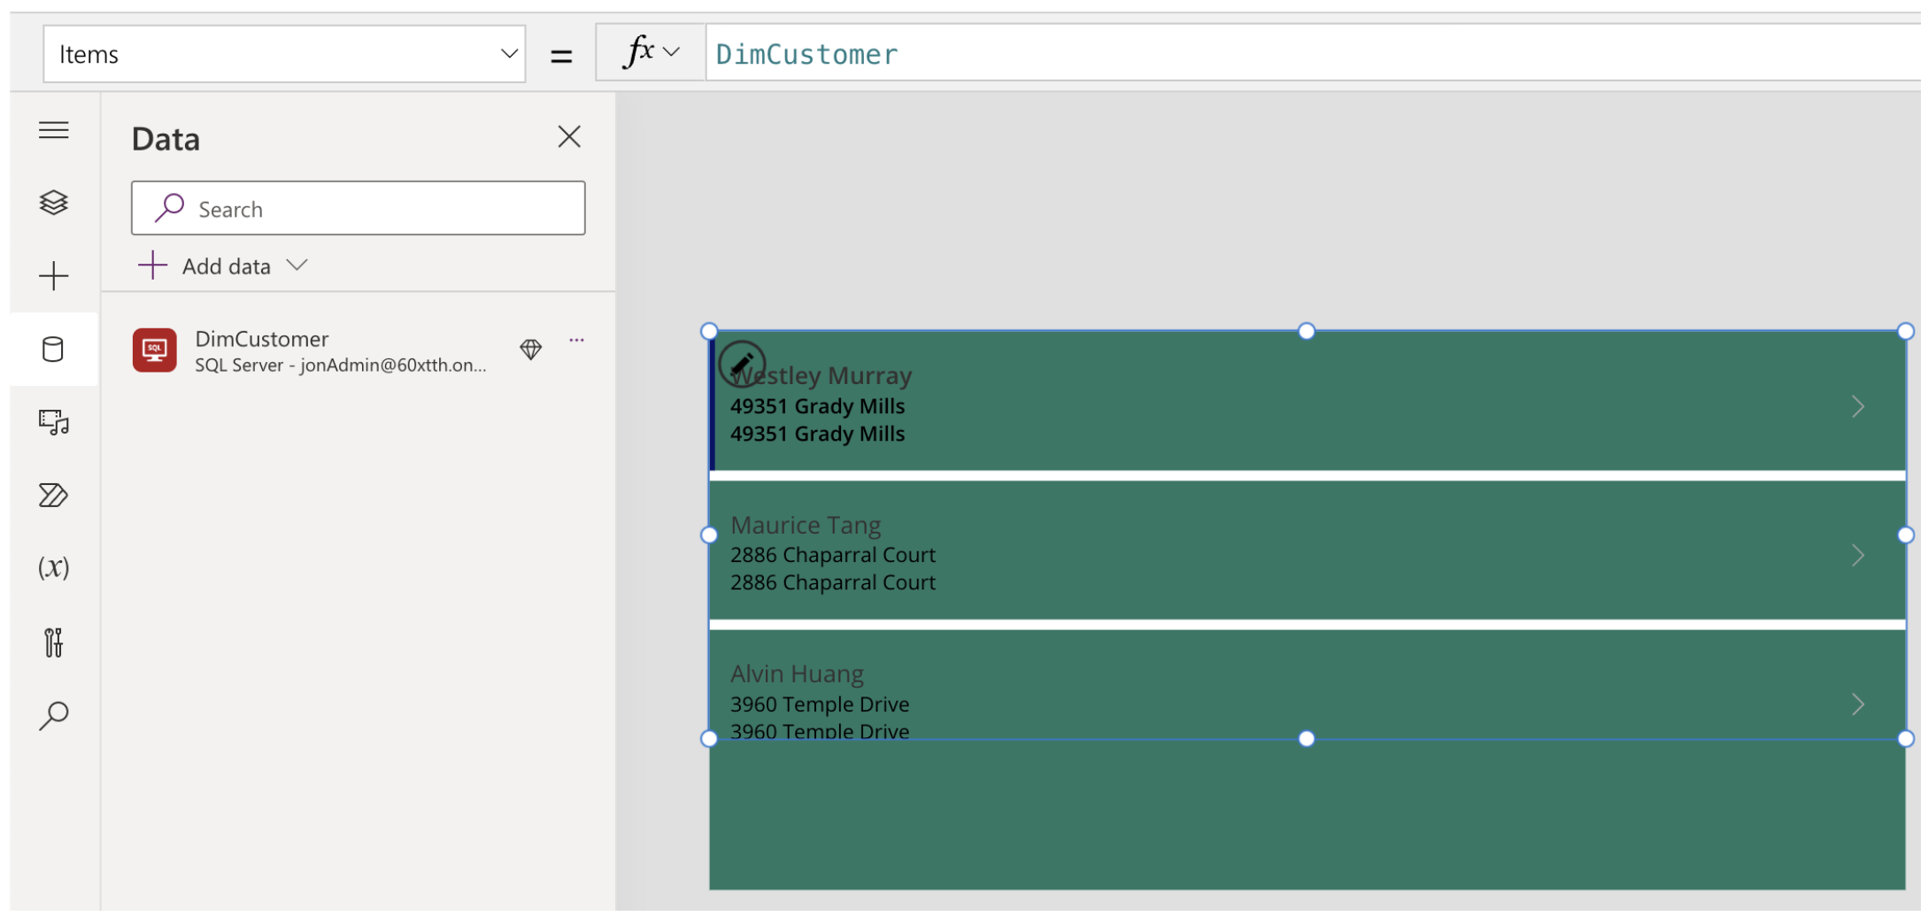
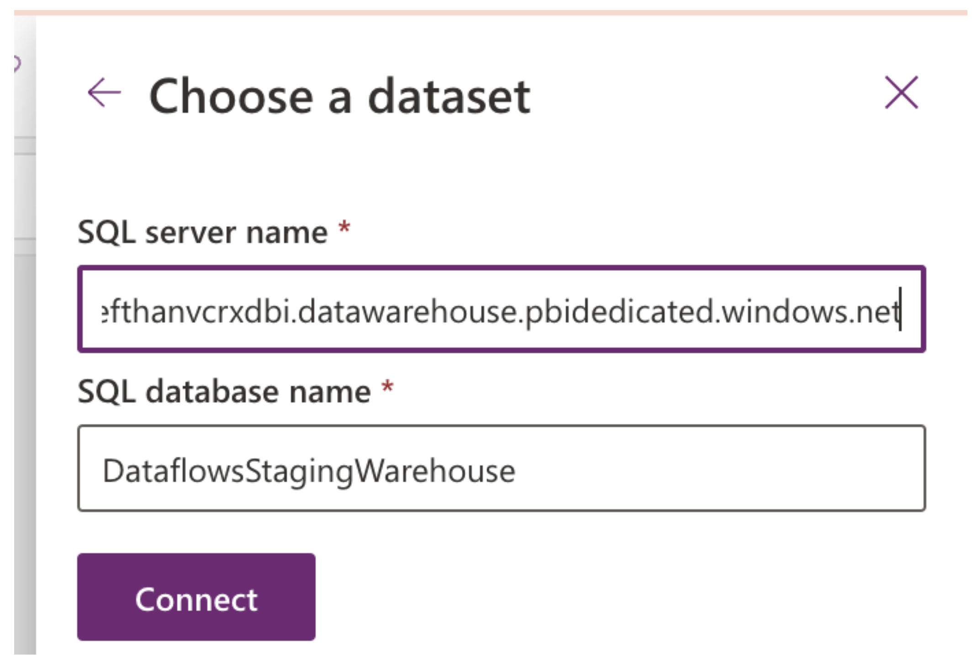
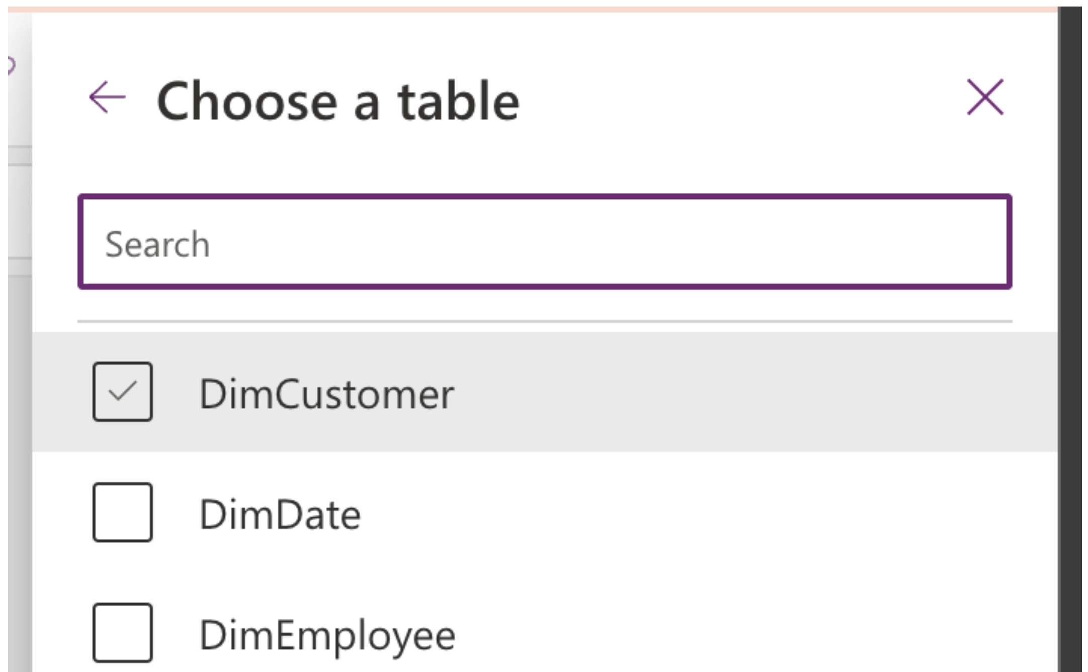
We can connect to Fabric Data Warehouses in Power Apps, and display data in the app:

Slide 7
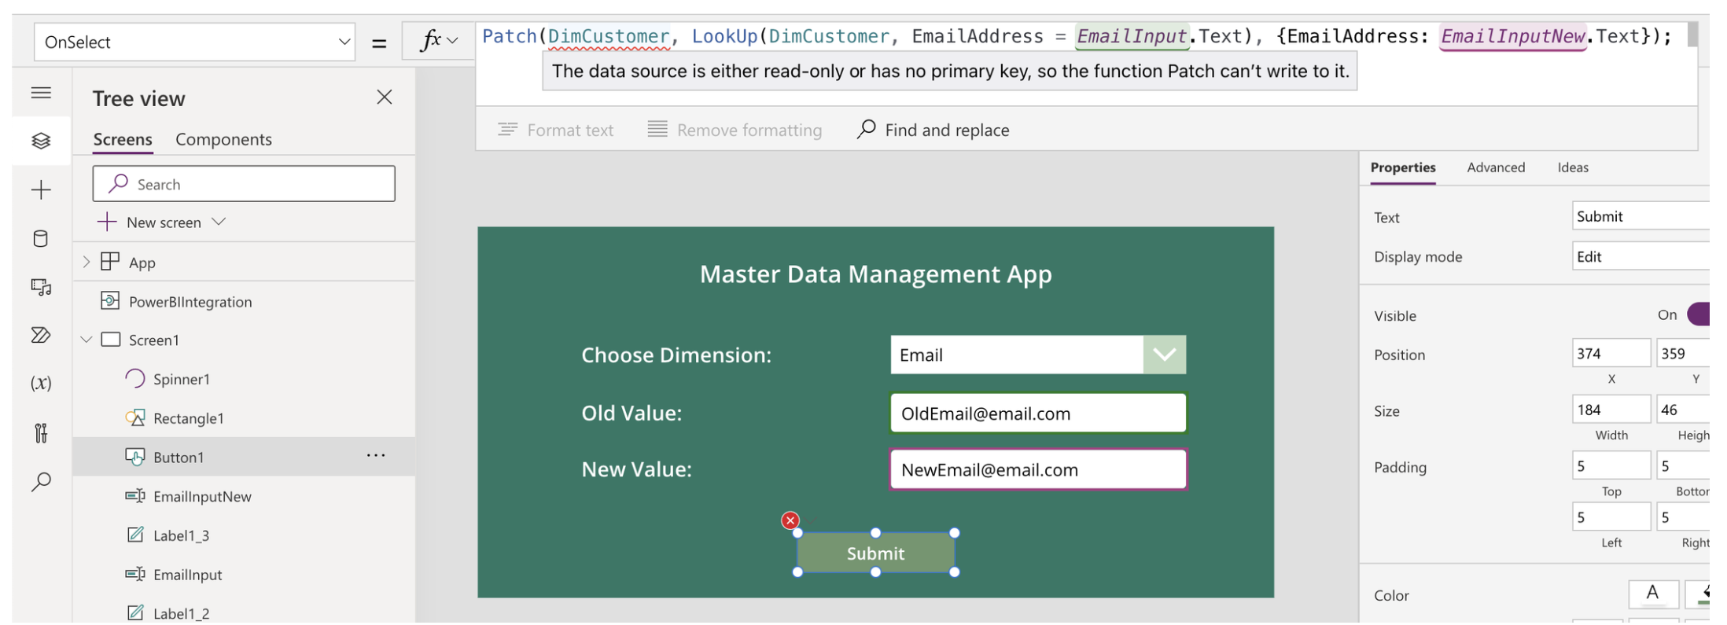
… but native Write-Back is not possible due to lack of enforced Primary Keys in Fabric.

Slide 8
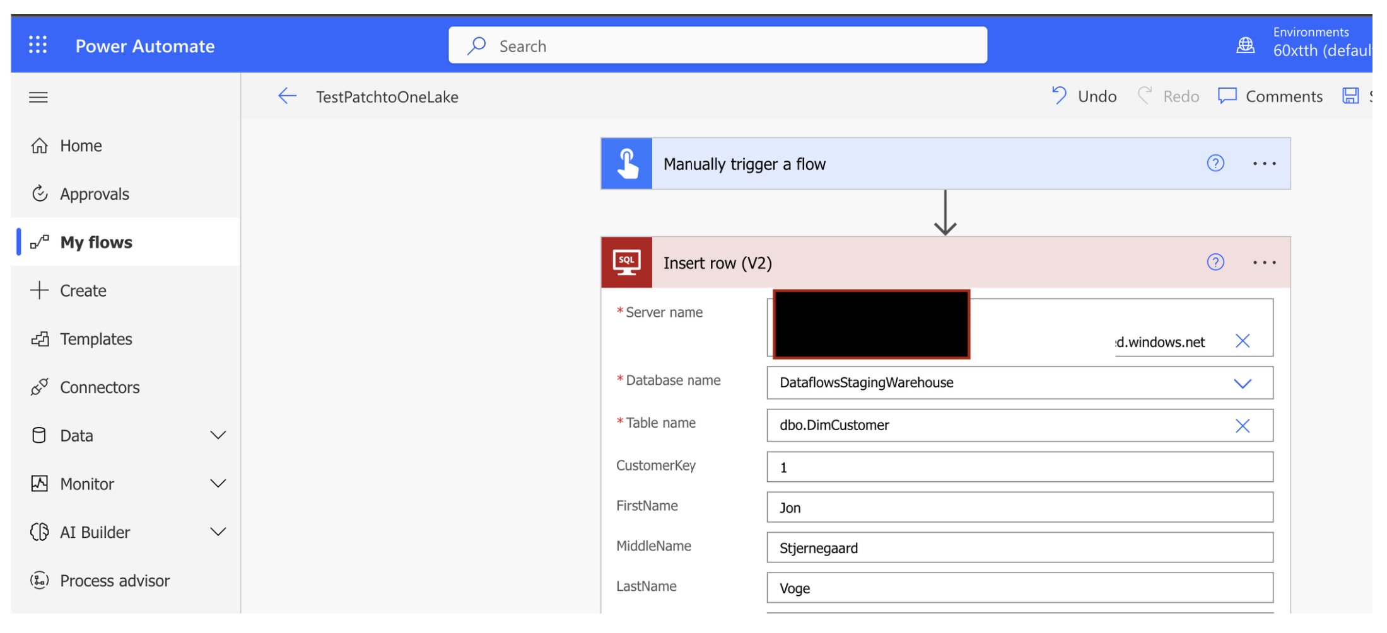
However. Power Automate can send Insert/Update SQL statements to the write-endpoint:

Slide 9
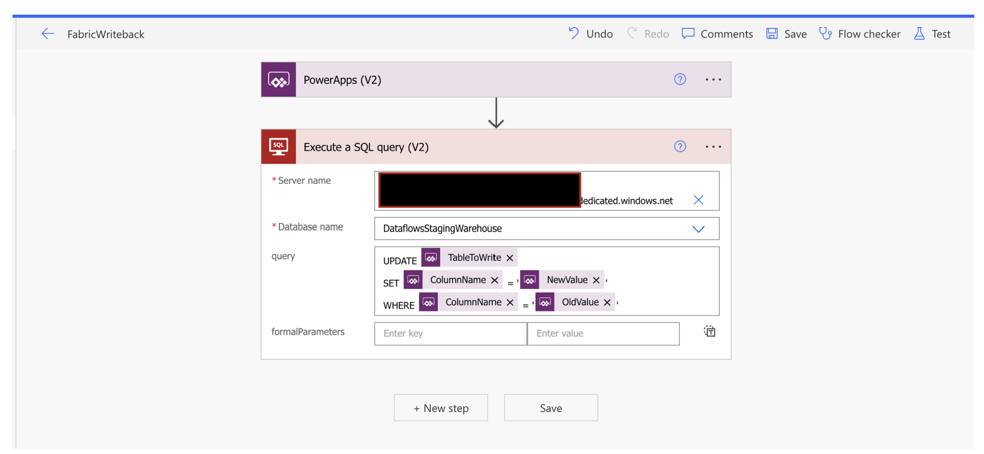
And we can parameterize the statement with values coming from Power Apps (and hence coming from Power BI):

Slide 10
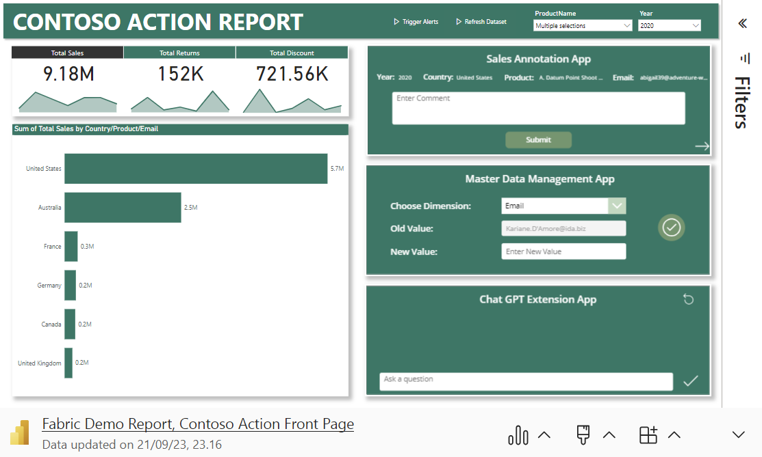
Bonus: Power Automate embedded in Power Apps embedded in Power BI embedded in Power Point

Slide 11
Recap:
Power Apps embedded in Power BI allows the end user to dynamically read, filter and combine data from Power BI Semantic Models and external data sources.
Power Apps can’t natively write-back to Fabric Data Warehouses, due to lack of enforced Primary Keys
Power Automate however can write to Fabric Data Warehouses by submitting Insert/Update SQL statements.
These Power Automate flows can be dynamically parameterized and orchestrated from within a Power App, embedded in Power BI, giving users write-back functionality directly in their reports.

Slide 12
Resources to study more
Articles:
Write-back to Fabric: https://www.linkedin.com/pulse/live-data-write-back-microsoft-fabric-warehouse-from-jon
Sync Dataverse to Fabric: https://www.linkedin.com/pulse/microsoft-fabric-power-platform-how-get-your-data-jon
Fabric Data Ingestion & Transformation for analysts: https://www.linkedin.com/pulse/fabric-analysts-part-1-data-ingestion-preparation-stjernegaard-v%25C3%25B6ge-fqu1e
Fabric Data Storage for analysts: https://www.linkedin.com/pulse/tutorial-fabric-analysts-data-storage-serving-jon-stjernegaard-v%25C3%25B6ge-sdgoe
Fabric Data Reporting for analysts: https://www.linkedin.com/pulse/tutorial-fabric-analysts-consuming-reporting-jon-stjernegaard-v%25C3%25B6ge-7lgwe
Fabric Data Activator for analysts: https://www.linkedin.com/pulse/tutorial-fabric-analysts-acting-data-activator-stjernegaard-v%25C3%25B6ge-a6dfe

Slide 13
Thank you
Connect with me:
LinkedIn: https://www.linkedin.com/in/jonvoge/
Other sessions available for conferences/user groups: https://sessionize.com/jon-voge
Download presentation material: https://github.com/Jonvoge/speaker-material
Stay online for my live Q&A sessions

